Slide 1
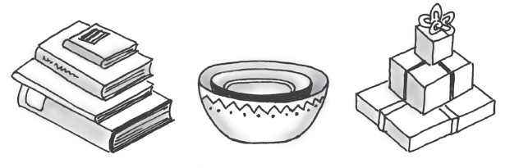
COMP 282 – Advanced Data Structures
Stacks
What is a stack?
Some familiar stacks
Add item on top of stack
Remove item that is topmost
– Last In, First Out … LIFO

Slide 2
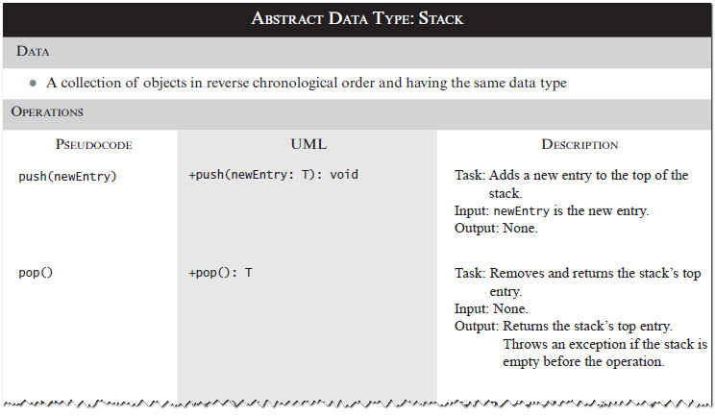
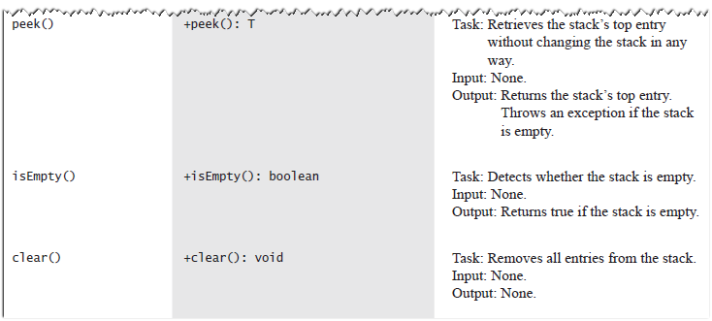
Specifications of the ADT Stack
Specifications of the ADT Stack

Slide 3
Design Decision
When stack is empty
What to do with pop and peek?
Possible actions
Assume that the ADT is not empty;
Return null.
Throw an exception (which type?).
The Stack Interface
// An interface for the ADT stack. public interface StackInterface<T>
{
// push() - Adds a new entry to the top of
//
//
//
this stack.
The parameter newEntry An object
to be added to the stack.
public void push(T newEntry);

Slide 4
// pop() - Removes and returns this stack's
//
//
//
//
//
//
top entry.
Returns the object at the top of the stack
Throws EmptyStackException if the stack is empty before the operation.
public T pop();
// peek() - Retrieves this stack's top entry.
//
//
//
//
Returns the object at the top of the stack.
Throws EmptyStackException if the stack is empty. */
public T peek();
// empty() - Detects whether this stack is
// empty.
// Returns true if the stack is
// empty
public boolean isEmpty();
// clear () - Removes all entries from this
// stack
public void clear();
}

Slide 5
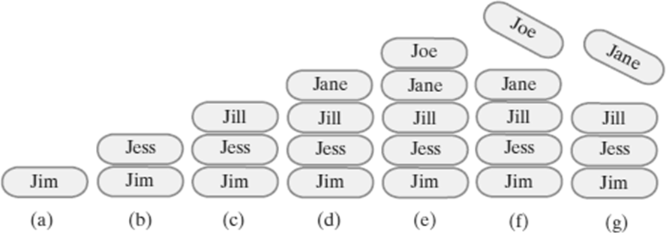
Example
(a) push adds Jim;
(c) push adds Jill;
(e) push adds Joe;
(b) push adds Jess;
(d) push adds Jane;
(f ) pop retrieves and removes Joe;
(g) pop retrieves and removes Jane
Security Note
Design guidelines
Use preconditions and postconditions to document assumptions.
Do not trust client to use public methods correctly.
Avoid ambiguous return values.
Prefer throwing exceptions instead of returning values to signal problem.

Slide 6
Notations for Algebraic Expressions
There are 3 different ways to write an algebraic expressions:
Infix – Standard algebra – 2 operands with the operator in the middle
Prefix – operator followed by 2 operands - aka
Polish notation
Postfix – 2 operands followed by an operator – aka Reverse Polish notation
Examples of Infix, Prefix, Postfix
Infix A + B, 3*x – y
Prefix +AB, -*3xy
Postfix AB+, 3x*y-

Slide 7
Converting to Infix to Postfix
A + B – C => A + [B*C]
=> A+[BC*]
=> A [BC*] +
=> ABC * +
Converting to Infix to Prefix
A + B * C => A + [B*C]
=> A+[*BC]
=> + A [*BC]
=> + A * BC

Slide 8
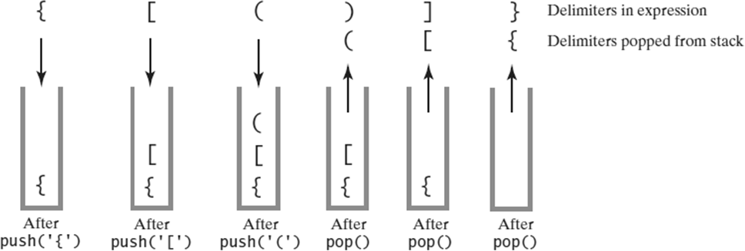
Conversion Examples
Infix | Prefix | Postfix
A + B | + A B | A B +
A + B – C | - + A B C | A B + C –
(A+B)*(C-D) | * + A B – C D | A B + C D - *
A^B*C-D+E/F/ (G+H) | +-*^ABCD //EF+GH | AB^C*D-EF/GH+/
Processing Algebraic Expressions
Scanning an expression that contains the balanced delimiters
{ [ ( ) ] }

Slide 9
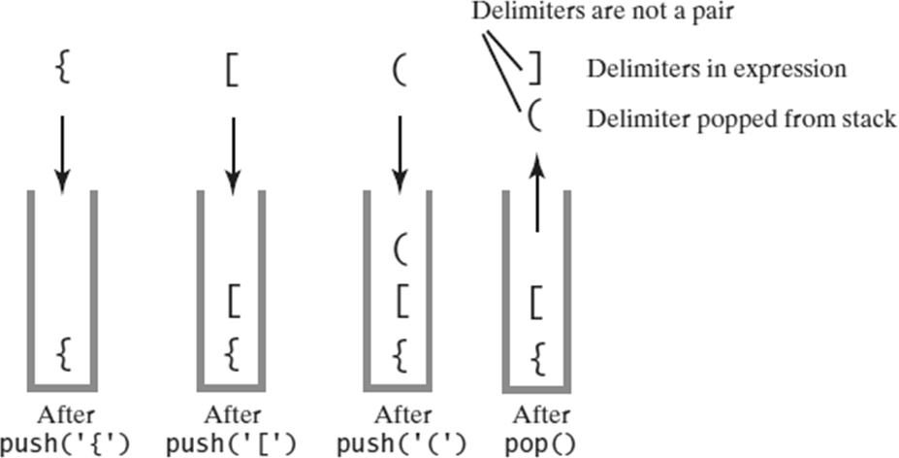
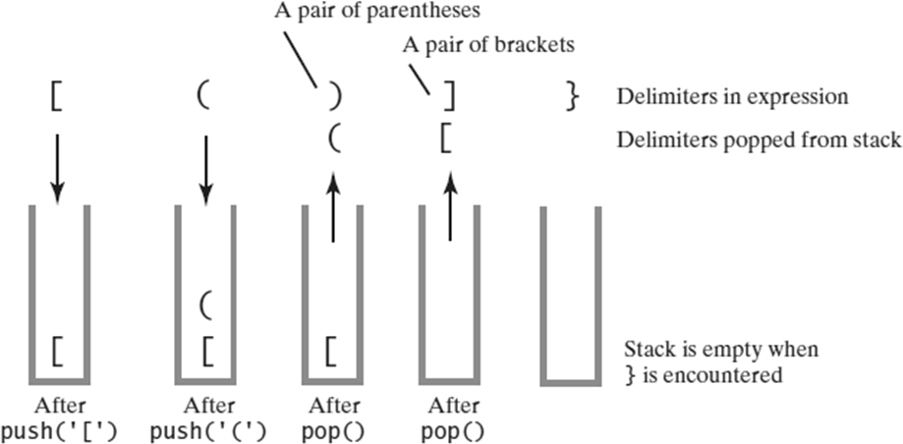
Processing Algebraic Expressions
Scanning an expression that contains the balanced delimiters
{ [ ( ] ) }
Processing Algebraic Expressions
Scanning an expression that contains the balanced delimiters
[ ( ) ] }

Slide 10
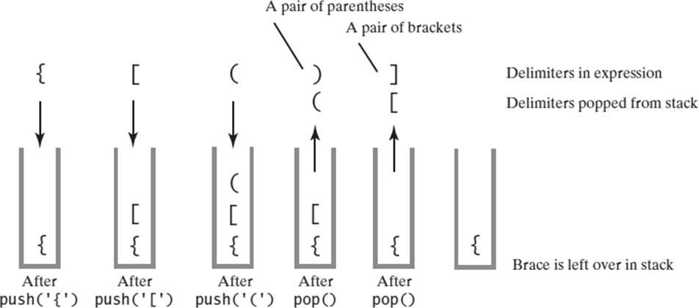
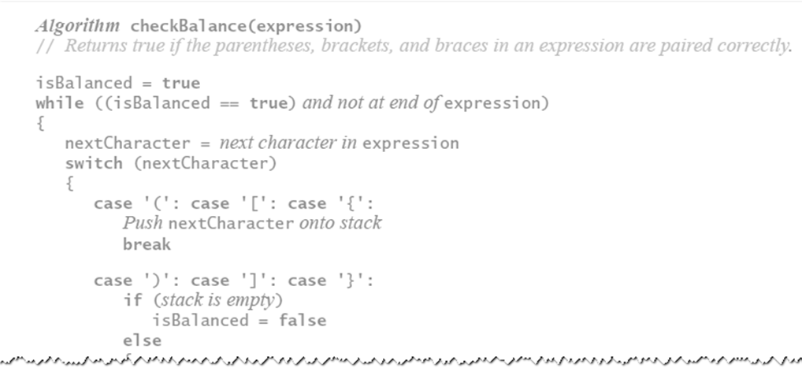
Processing Algebraic Expressions
Scanning an expression that contains the balanced delimiters
{ [ ( ) ]
Algorithm for Processing Algebraic Expressions

Slide 11
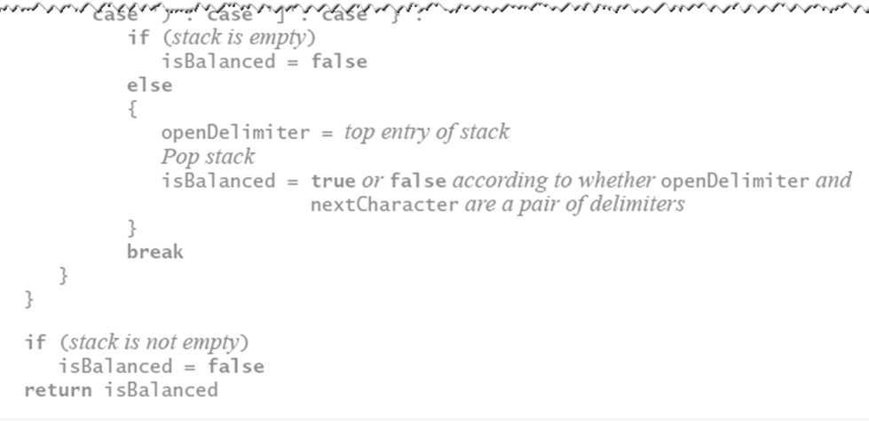
Algorithm for Processing Algebraic Expressions
BalanceChecker()
// A class that checks whether the parentheses,
// brackets, and braces in a string occur in
// left/right pairs.
public class BalanceChecker {
// Decides whether the parentheses, brackets,
// and braces in a string occur in left/right
// pairs.
// Returns true if the delimiters are paired
// correctly
public static boolean
checkBalance(String expression) { StacInterface<Character>
openDelimiterStack = new ArrayStack<>();

Slide 12
int characterCount = expression.length(); boolean isBalanced = true;
int index = 0;
char nextCharacter = ' ';
while (isBalanced &&
(index < characterCount)) { nextCharacter = expression.charAt(index); switch (nextCharacter) {
case '(': case '[': case '{': openDelimiterStack.push(nextCharacter); break;
case ')': case ']': case '}':
if (openDelimiterStack.isEmpty()) isBalanced = false;
else {
char openDelimiter
= openDelimiterStack.pop(); isBalanced = isPaired(openDelimiter,
nextCharacter);
}
break;
// Ignore unexpected characters default: break;
}
index++;
}

Slide 13
if (!openDelimiterStack.isEmpty()) isBalanced = false;
return isBalanced;
}
// Returns true if the given characters, open and
// close, form a pair of parentheses, brackets,
// or braces.
private static boolean isPaired(char open,
char close) { return (open == '(' && close == ')') ||
(open == '[' && close == ']') ||
(open == '{' && close == '}');
}
}

Slide 14
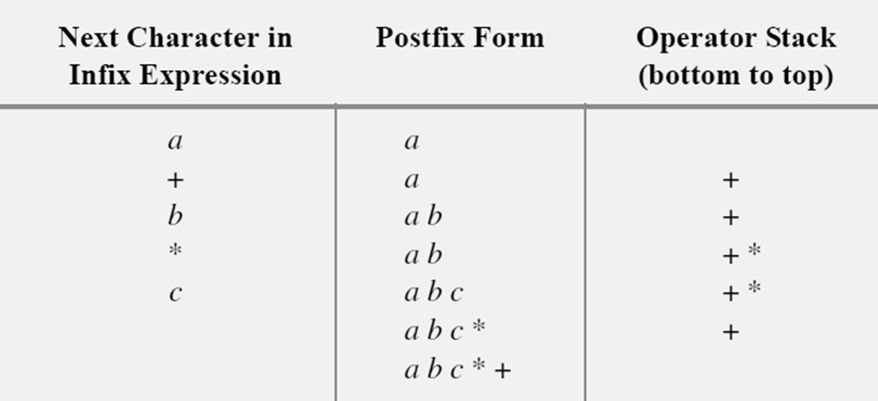
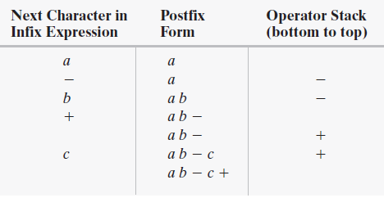
Converting a + b * c Postfix
Converting a - b + c Postfix

Slide 15
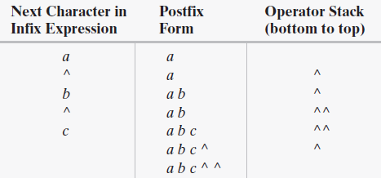
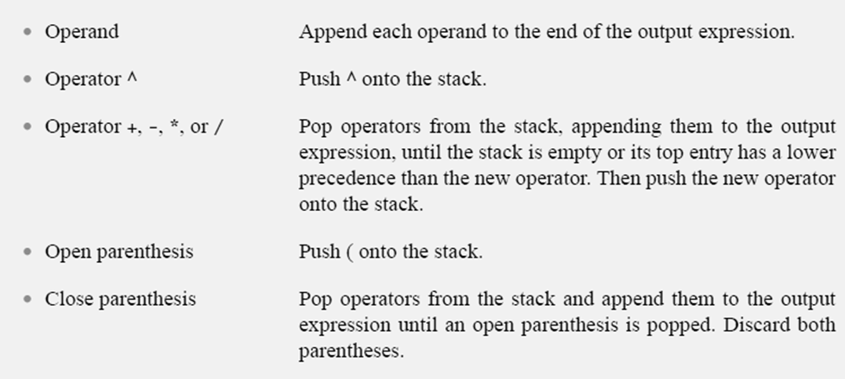
Converting a ^ b ^ c Postfix
Infix to Postfix Conversion

Slide 16
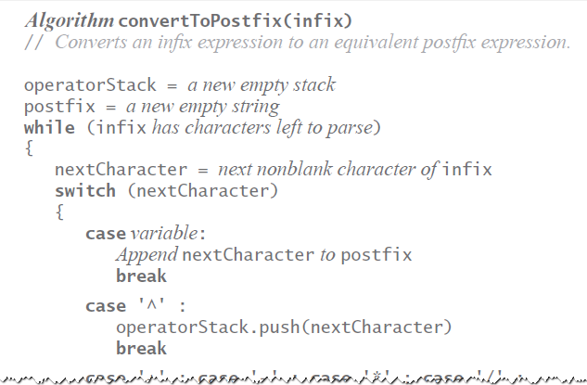
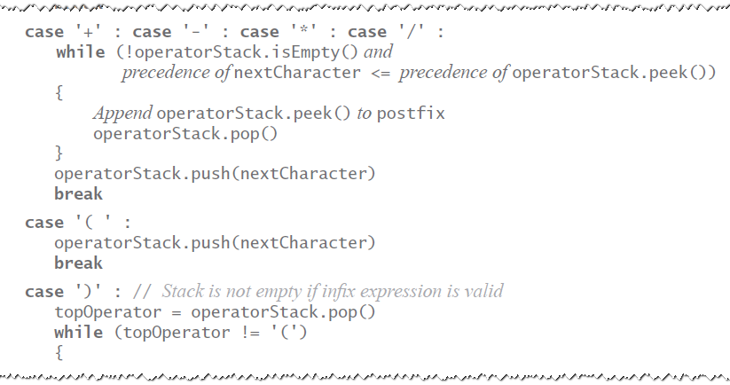
Infix to Postfix Conversion Algorithm
Infix to Postfix Conversion Algorithm

Slide 17
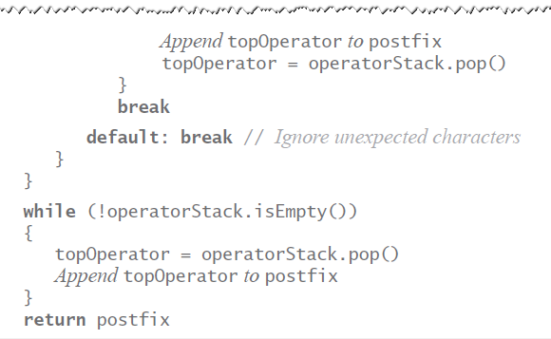
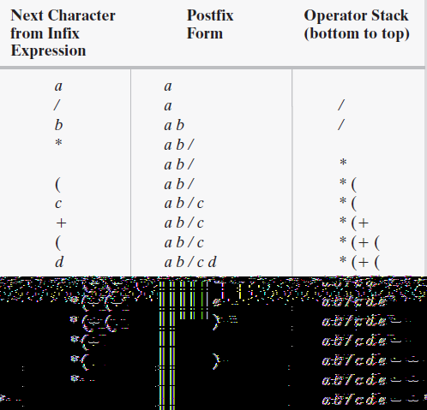
Infix to Postfix Conversion Algorithm
Converting a / b * (c + (d - e))
to Postfix

Slide 18
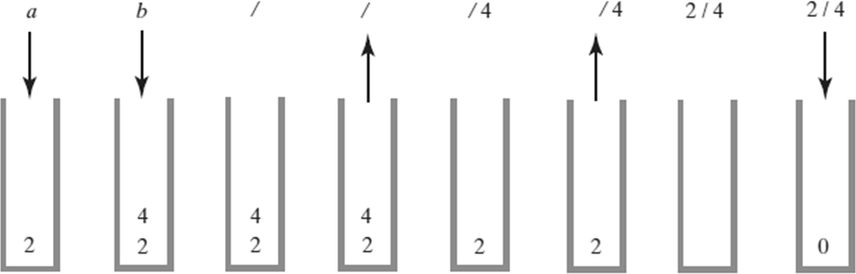
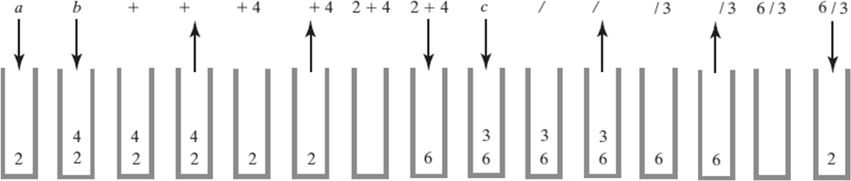
Evaluating Postfix Expressions
Evaluating a b / where a = 4 and b = 2
Evaluating Postfix Expressions
Evaluating a b + c / when a is 2, b is 4, and c is 3

Slide 19
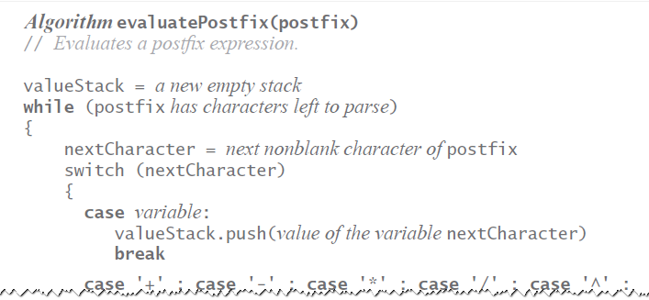
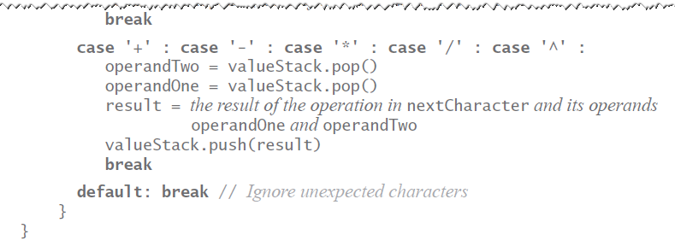
Algorithm for Evaluating Postfix Expressions
Algorithm for Evaluating Postfix Expressions

Slide 20
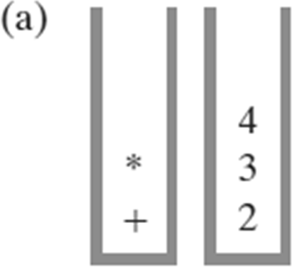
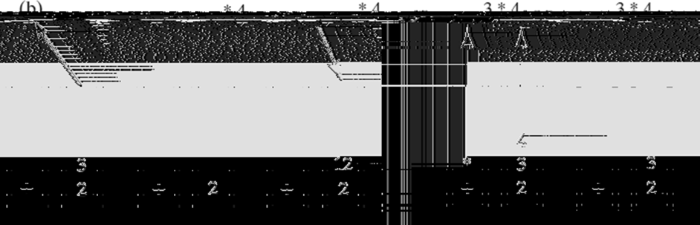
Evaluating a + b * c when a is 2,
b is 3, and c is 4
Evaluating a + b * c –
Performing the Multiplication

Slide 21
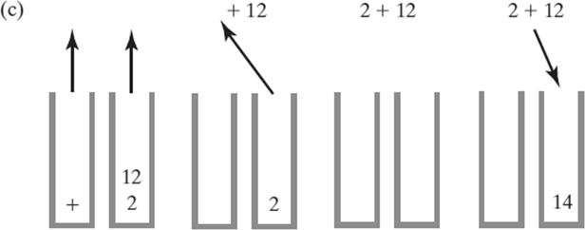
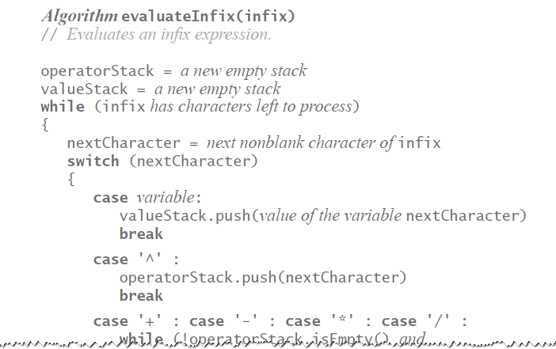
Evaluating a + b * c –
Performing the Addition
Algorithm for Evaluating infix Expressions

Slide 22
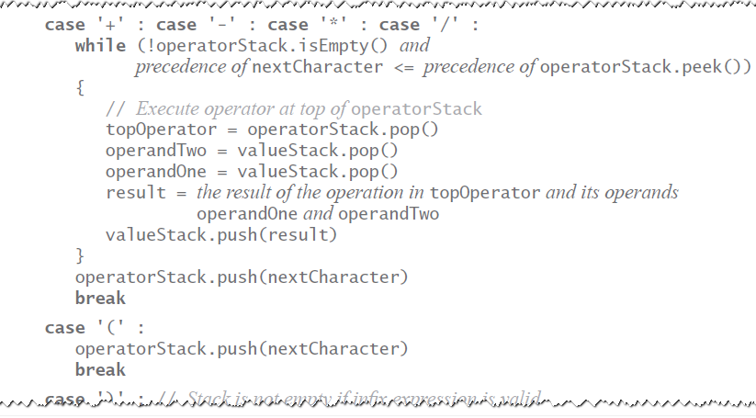
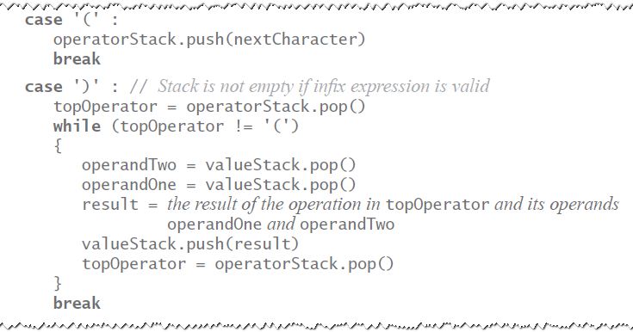
Algorithm for Evaluating infix Expressions
Algorithm for Evaluating infix Expressions

Slide 23
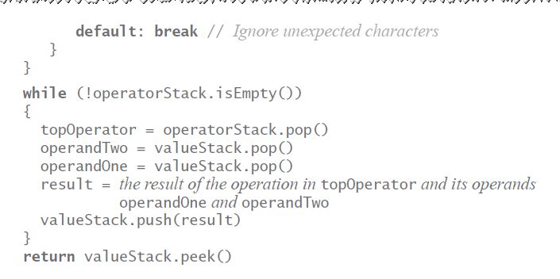
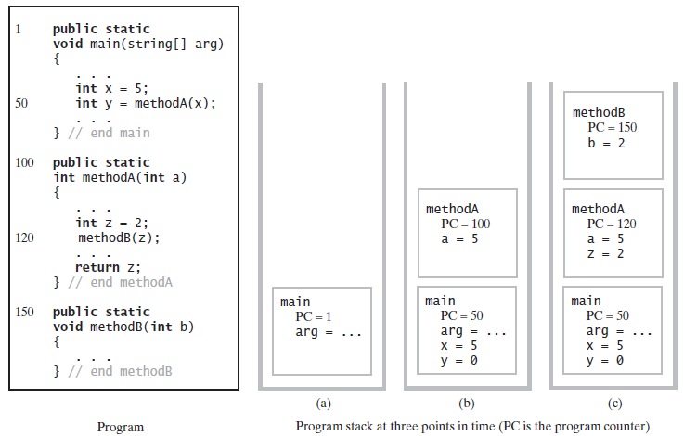
Algorithm for Evaluating infix Expressions
The Program Stack
when main begins execution;
when methodA begins execution;
when methodB begins execution

Slide 24
Java Class Library: The Class Stack
Found in java.util
Methods
– A constructor – creates an empty stack
public
public
public
public
T push(T item); T pop();
T peek();
boolean empty();
Linked Implementation
Each operation involves top of stack
push
pop
peek
Head of linked list easiest, fastest to access
Let this be the top of the stack

Slide 25
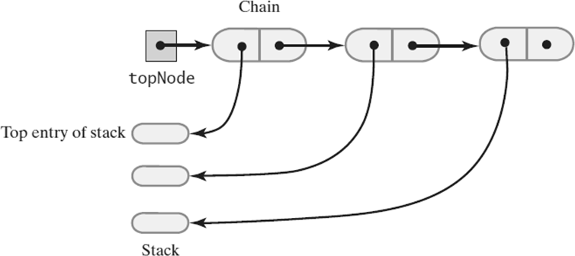
Linked Implementation
A chain of linked nodes that implements a stack
Linked Implementation
// A class of stacks whose entries are stored in
// a chain of nodes.
public final class LinkedStack<T>
implements StackInterface<T> {
// References the first node in the chain private Node topNode;
public LinkedStack() { topNode = null;
}
// Stack operations go here

Slide 26
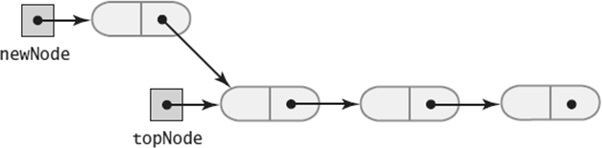
private class Node {
private T data; // Entry in stack private Node next; // Link to next node
// Constructors, accessors and mutators go
// here
}
}
Linked Implementation
A new node that references the node at the top of the stack

Slide 27
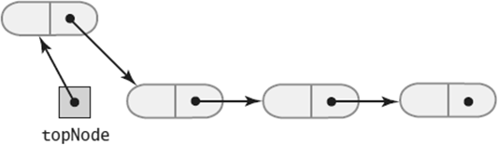
Linked Implementation
The new node is now at the top of the stack
push()
public void push(T newEntry) {
Node newNode = new Node(newEntry, topNode); topNode = newNode;
}

Slide 28
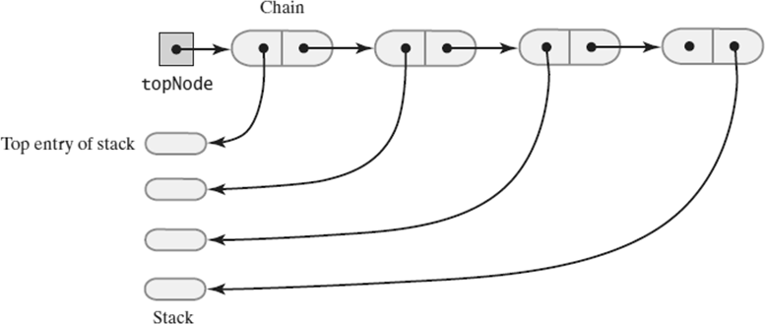
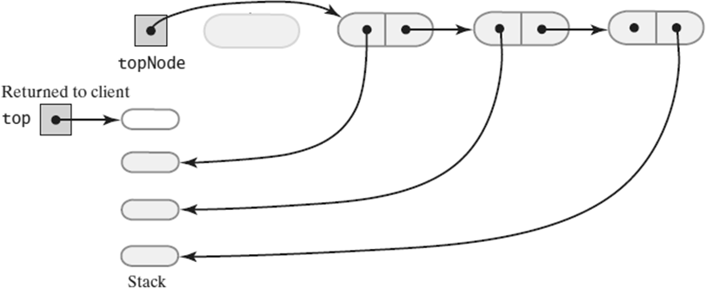
Linked Implementation
The stack before the first node in the chain is deleted
Linked Implementation
The stack after the first node in the chain is deleted

Slide 29
pop()
public T pop() {
// Might throw EmptyStackException T top = peek();
assert (topNode != null); topNode = topNode.getNextNode(); return top;
}
isEmpty() and clear()
public boolean isEmpty() { return topNode == null;
}
public void clear() {
// Causes deallocation of nodes in the chain topNode = null;
}

Slide 30
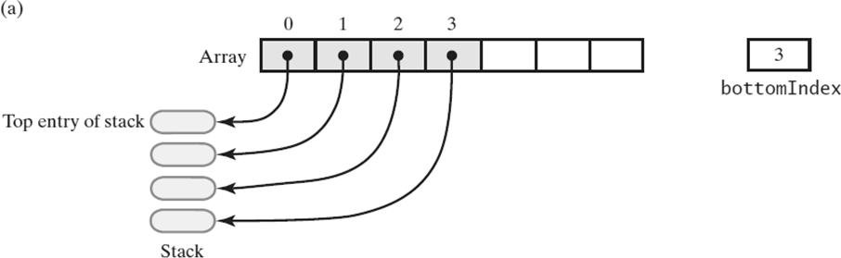
Array-Based Implementation
Each operation involves top of stack
push
pop
peek
End of the array easiest to access
Let this be top of stack
Let first entry be bottom of stack
Array Implementation
An array that implements a stack; its first location references the top entry in the stack;

Slide 31
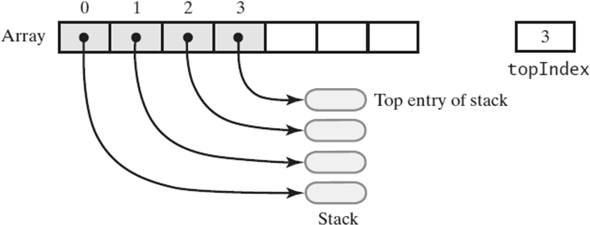
Array Implementation
An array that implements a stack; its first location references the bottom entry in the stack
Array Implementation
import java.util.Arrays;
import java.util.EmptyStackException;
// A class of stacks whose entries are stored in
// an array.
public final class ArrayStack<T>
implements StackInterface<T> {
// Array of stack entries private T[] stack;
// Index of top entry private int topIndex;
private boolean initialized = false;

Slide 32
private static final int DEFAULT_CAPACITY = 50; private static final int MAX_CAPACITY = 10000;
public ArrayStack() { this(DEFAULT_CAPACITY);
}
public ArrayStack(int initialCapacity) { checkCapacity(initialCapacity);
// The cast is safe because the new array
// contains null entries @SuppressWarnings("unchecked") T[] tempStack
= (T[]) new Object[initialCapacity];
stack = tempStack; topIndex = -1; initialized = true;
}
// Implementations for stack operations and
// checkCapacity and checkInitialization go
// here

Slide 33
Adding to the top - push()
public void push(T newEntry) { checkInitialization(); ensureCapacity();
stack[topIndex + 1] = newEntry; topIndex++;
}
Adding to the top - checkCapacity()
private void checkCapacity(int capacity) if (capacity > MAX_CAPACITY)
throw new IllegalStateException ("Attempt to create a stack "
+ "whose capacity exceeds "
+ "allowed maximum.");
}
{

Slide 34
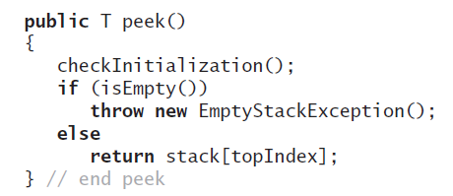
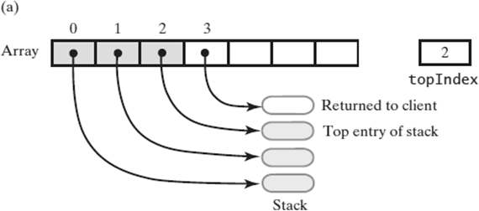
Array-Based Implementation
Retrieving the top, the operation is O(1)
Array-Based Implementation
An array-based stack after its top entry is removed by decrementing topIndex;

Slide 35
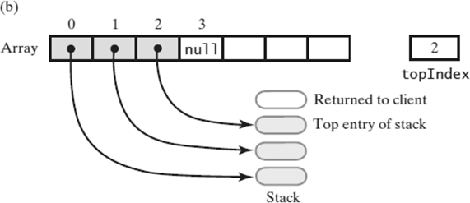
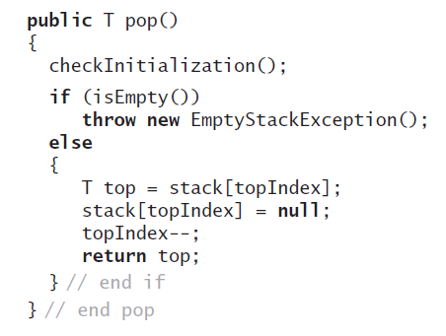
Array-Based Implementation
An array-based stack after its top entry is removed by setting stack[topIndex] to null and then decrementing topIndex
Array-Based Implementation
Removing the top

Slide 36
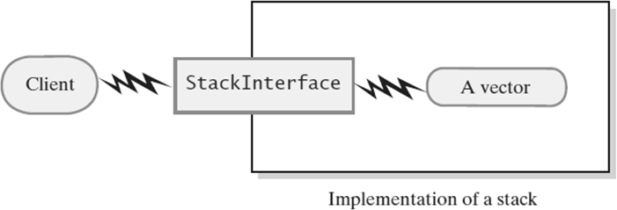
Vector Based Implementation
Vector: an object that behaves like a high- level array
Index begins with 0
Methods to access or set entries
Size will grow as needed
Use vector’s methods to manipulate stack
Vector Based Implementation
A client using the methods given in StackInterface; these methods interact with a vector’s methods to perform stack operations

Slide 37
The Class Vector
Constructors
Has methods to add, remove, clear
Also methods to determine
Last element
Is the vector empty
Number of entries
Vector Implementation
import java.util.Vector;
import java.util.EmptyStackException;
// A class of stacks whose entries are stored
// in a vector.
public final class VectorStack<T> implements StackInterface<T> {
// Last element is the top entry in stack private Vector<T> stack;
private boolean initialized = false;
private static final int DEFAULT_CAPACITY = 50; private static final int MAX_CAPACITY = 10000;

Slide 38
public VectorStack() { this(DEFAULT_CAPACITY);
}
public VectorStack(int initialCapacity) checkCapacity(initialCapacity);
{
// Size doubles as needed
stack = new Vector<>(initialCapacity); initialized = true;
}
// Implementations of stack operations and
// checkInitialization and checkCapacity go
// here
}
Vector Implementation
Adding to the top
public void push(T newEntry) checkInitialization(); stack.add(newEntry);
}
{

Slide 39
peek()
Retrieving the top
public T peek() { checkInitialization(); if (isEmpty())
throw new EmptyStackException(); else
return stack.lastElement();
}
pop()
Removing the top
public T pop() { checkInitialization(); if (isEmpty())
throw new EmptyStackException(); else
return stack.remove(stack.size() - 1);
}

Slide 40
Rest of the VectorStack Class
public boolean isEmpty() return stack.isEmpty();
}
{
public void clear() stack.clear();
}
{

